Slide 1

Facing Problems of the Nurses in the Real World
And
Interprofessional Education
Professor Nang Awng
Pro-Rector (Administration)
University of Nursing, Mandalay
3.9.2020

Slide 2

Introduction
Nurses play one of the most vital roles in the delivery of care within the healthcare settings
Nurses and midwives account for nearly 50% of the global health workforce
WHO estimates that the world will need an additional 9 million nurses and midwives by the year 2030
Nurses are facing the many challenges in the today’s complex health care environment

Slide 3
Top 7 Professional Challenges Faced By Nurses in the 21st Century
Long working Hours
Less compensation
Workplace violence
Lack of respect from others
Exposure to hazardous chemicals
Exposure to diseases
Shortage of nursing staff
(Spencer, 2013)
United Kingdom

Slide 4
Day to day problem in nursing services
Shortage of nurses
Lack of motivation
Negative attitude
Lack of training
Lack of team approach
Inactive participation of program
Lack of interpersonal relationship
Less involvement in patients care by nursing supervisors
Lack of supervision
(Thomas, 2014)
Government College of Nursing, Alappuzha, India

Slide 5
5 of the biggest issues nurses face today
Short-staffing in hospital settings is a top concern for nurses
Long working hours
Workplace hazards
Workplace violence
Bullying and harassment
Becker’s Hospital Review, 2018
United State of America

Slide 6
Problems and challenges faced by nurses in hospital
(India)
Shortage of staff nurse
Working hours
Assigning duties
Low salary
Questioning nurses for every problem in hospital
Food and accommodation
Disrespect for nurses
Lack for abroad opportunity
Disrespect from society
(Kumar, 2020)

Slide 7
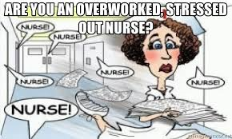
Facing problems of the nurses in the real world (Myanmar)
Role conflict
Limited Human Resources
Nursing shortage
Long working hours
Too much time devoted to paperwork
Underestimate (for salary and job position)

Slide 8


Slide 9
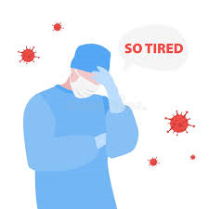

Disrespect for nurses (working environment)
Limited accommodation and food
International migration
Workplace Hazards (Physical, Chemical, Biological, Psychological, Ergonomic)
Workplace violence

Slide 10

Limited professional autonomy in government administration
Lack of interprofessional education and Interprofessional collaborative practice knowledge
Lack of places at the high table on policy issues

Slide 11
Roles of a nurse in clinical setting https://www.news-medical.net/health/Roles-of-a-Nurse.aspx#
The primary role of a nurse is:
to advocate and care for individuals of all ethnic origins and religious backgrounds and support them through health and illness.

Slide 12
However, there are various other responsibilities of a nurse that form a part of the role of a nurse, including to:
Record medical history and symptoms
Collaborate with team to plan for patient care
Advocate for health and wellbeing of patient
Monitor patient health and record signs

Slide 13
Administer medications and treatments
Operate medical equipment
Perform diagnostic tests
Educate patients about management of illnesses
Provide support and advice to patients
Smith, 2019

Slide 14
Code of Ethics and Nursing –Midwifery Professional Conduct
Value Statement 1: Respect Client's Values, Beliefs, Customs and Needs
Value Statement 2: Respect Client's Rights to Have Autonomy
Value Statement 3: Respect Client's Rights to Confidentiality

Slide 15
Value Statement 4: Respect Client's Rights to Preserve Privacy and Dignity Value Statement
Value Statement 5: Provide Care in a Responsible and Accountable Manner
Value Statement 6: Maintain Competency in the Care of Clients

Slide 16
Value Statement 7: Maintain Ethical Standards in the Conduct of Nursing Research
Value Statement 8: Provide an Ethical, Conducive Environment to Practice
Value Statement 9: Promote Professional Ethical Standards and Maintain Public Trust on the Nursing Profession
Value Statement 10: Refrain from Professional Misconduct

Slide 17
သူနာပြုသစ္စာအဓိဌာန်
 | ကျွန်ုပ်တို့သည်
၁။ | လူသားအားလုံး၏ ကိုယ်ကျန်းမာရေး၊ စိတ်ကျန်းမာရေးကို အကျွန်ုပ်၏ အရေးကဲ့သို့ယူဆပါအံ့။
၂။ | သူနာပြုများ၏ဂုဏ်သိက္ခာကို ထိန်းသိမ်းပြီး အကျင့်စာရိတ္တပျက်ပြားမှုမှ ရှောင်ကြဉ်ပါအံ့။
၃။ | ကိုယ်စွမ်းဉာဏ်စွမ်းရှိသမျှ ဂီလာနပုဂ္ဂိုလ်များအား လူမျိုး၊ ဘာသာ၊ အဆင့်အတန်းအခွဲခြားဘဲ ပြုစုပါအံ့။
၄။ | လူသားတို့၏ အသက်အန္တရာယ်နှင့် ကျန်းမာရေးကို ထိခိုက်စေနိုင်မည့် မည်သည့်အပြုအမှုမျိုး ကိုမဆို တားဆီးကာကွယ်ပါအံ့။
၅။ | လူနာ၏ ဝေဒနာသက်သာမှုနှင့် ကျန်းမာရေးတိုးတက်မြင့်မားလာစေရန် အခြားကျန်းမာရေး ဝန်ထမ်းများနှင့်ပူးပေါင်း၍ အစွမ်းကုန်ကြိုးစားဆောင်ရွက်ပါအံ့။
၆။ | လူနာ၏ ဂုဏ်သိက္ခာနှင့် ကိုးကွယ်ယုံကြည်မှုများကို အစဉ်လေးစားပါအံ့။
ရ။ | လူနာ၏ အတွင်းရေးကိစ္စများကို ပြောဆိုသင့်သည့်အချက်များမှအပ လျှို့ဝှက်ချက်အနေဖြင့် စောင့်ထိန်းပါအံ့။
၈။ | သူနာပြုများလိုက်နာရမည့်ကျင့်ဝတ်များကို စောင့်ထိန်း၍ သူနာပြုအချင်းချင်းထာဝစဉ်စည်းလုံး ညီညွတ်ရန် အမြဲတစေဆောင်ရွက်ပါအံ့။

Slide 18
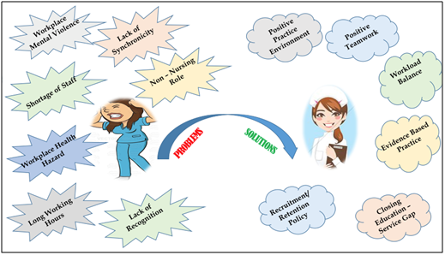


Slide 19
Interprofessional Education
Students learn together for:
  Preparing students of the health profession to work together, with a common goal of building a safer and better patient-centered, population-oriented health care system

Slide 20


Inter-Professional Education (IPE) Competencies
The WHO framework outlined 4 competency domains:
  Values/ethics of inter-professional practice
  Roles and responsibilities
  Inter-professional communication
  Teams and teamwork

Slide 21
Understanding:_
  Values/ethics of inter-professional practice
  Roles and responsibilities
As well as
  Understanding:_
  Own and the other professions of Values/ethics
  Own and the other professions of Roles and responsibilities

Slide 22


Conclusion
The growing complexity of health problems necessarily makes professionals interdependent
Building good relationships with professionals in other disciplines leads to better understanding
To provide proper care and improve patient outcomes:_
  healthcare professional must collaborate effectively with members of the healthcare team from other disciplines

Slide 23
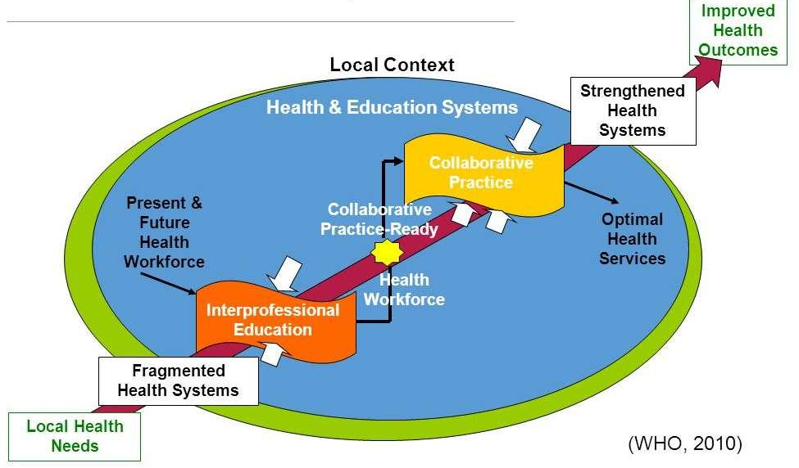
Learn together to work together

Slide 24
References
Becker’s Hospital Review (2018) https://www.beckershospitalreview.com/ workforce /5-of-the-biggest-issues-nurses-face-todayjune15.html
Kumar, A. (2020) Problems and challenges faced by nurses in hospital: A Detailed Report, https//www.cancestar.com/problems-and-challenges-faced-bynurses-in-hospital.html
Myanmar Nurses and Midwifery Council (2015) Code of Ethics and Nursing –Midwifery Professional Conduct
Smith, Y. (2019) Roles of a nurse in clinical setting, https://www.news-medical.net/health/Roles-of-a-Nurse.aspx#
Spencer, A. (2013) Top 7 Professional Challenges Faced By Nurses in the 21st Century, http://newnursehelp.com/top-7-professional- challenges-faced-by-nurses-in-the-21st-century/
Thomas, D.P. (2014) organizing nursing services, organizing patient care, https://www.slideshare.net/deepthyphilipthomas /organizing-nursing-services, Government College of Nursing, Alappuzha
World Health Organization (2010) Framework for action on interprofessional education and collaborative practice

Slide 25

